Slide 1
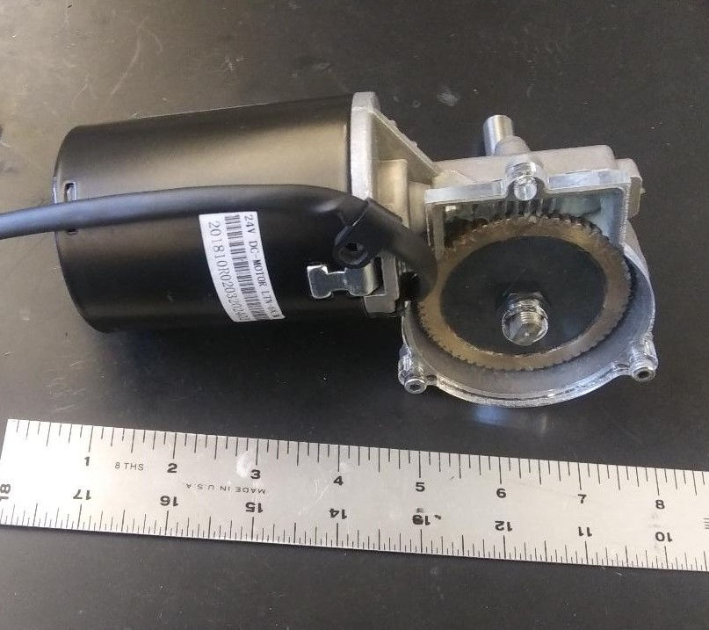

Abstract
Motors

